Slide 1

Design and analysis of algorithms (CSE 2012)
Prepared by
Dr.S.Jenicka
Assistant professor senior grade 2
SCOPE-Analytics
VIT Vellore

Slide 2
Robin Karp algorithm
Let a= 1;b=2;c=3;d=4;e=5;f=6;g=7;h=8;i=9
Text: ccabadccadba
Pattern:dba, m=3 (window size)
Hash value of dba= 4.10²+ 2.10¹ + 1. 10⁰ = 421
Hash value cca=3.10²+ 3.10¹ + 1. 10⁰= 331
Hash value cab= 3.10²+ 1.10¹ + 2. 10⁰= 312
and so on. To shift to the next rolling window of text,
331-300=31*10+2=312 where no of decimal digits =10.
Take the most significant digit 3, multiply it with 100 (value of the digit “1” in the high-order position of an m-digit text window) to get 300.
Subtract 300 from 331(hash value of the current window of text)
Multiply it with 10 to get 310
Add 310 with 2 (first character in the next nonoverlapping window of text)

Slide 3
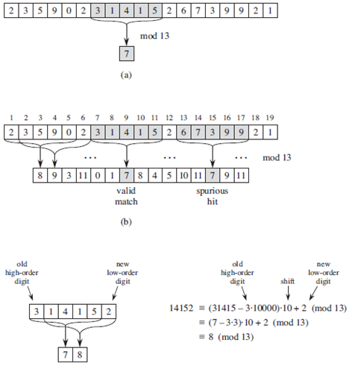
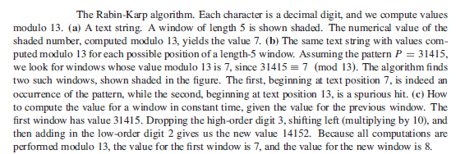
Robin Karp algorithm

Slide 4
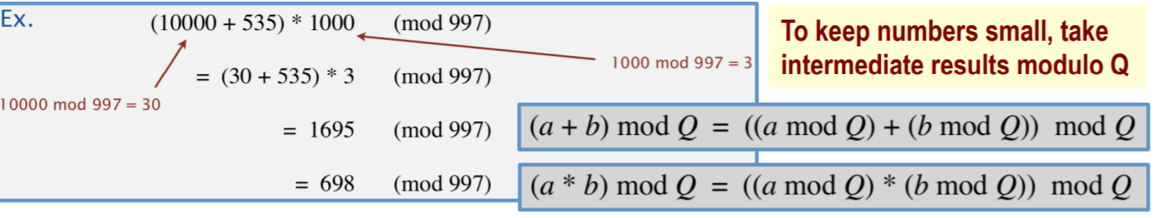
Modular arithmetic
Note: How to do modular arithmetic with -ve numbers? One way to think of this is that working mod M you are free to add or subtract M as much as you like, since M is equivalent to 0 mod M. So we have (7-3.3).10 + 2 (mod 13) = -2.10 + 2 = -18 = 13 + 13 - 18 = 8 mod 13

Slide 5
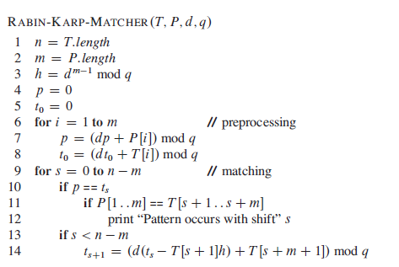

Robin Karp algorithm
This is a general procedure for finding hash of d-ary digits. To find the hash value of pattern (p), the characters are taken one by one from the least position to the highest position, multiplied with d and modulus is found (as in steps 4 to 8). Likewise the same procedure is adapted for finding the hash value of the first window of text (t₀). For example if pattern is 135 and d=10, to find 135 mod 13=5
Iteration 1: p=(10.0+ 1)mod 13=1,
Iteration 2: p=(10.1+3)mod 13=0,
Iteration 3: p=(10.0+5) mod 13=5 (solution)
h ≡d^{m-1} mod q is the value of the digit “1” in the high-order position of an m-digit text window.
For example,
(1* 10000) mod 13, if m=5, d=10 and q=13
p- hash value of the pattern
t - hash value of the text
Only if s<n-m, the for loop is iterated.
t_{s} is the hash value of the current window of characters in the text
So t_{s+1} is the hash value of the next window of characters in the text
h=10000 mod 13 =3
T(s+1, s+m) is the current text to be matched with pattern= 31415
T(s+m+1) is the character in s+m+1 position =2
t_{s} = 31415 mod 13=7 (hash value of 31415)
t_{s+1} = 14152 mod 13=8 (hash value of 14152)

Slide 6
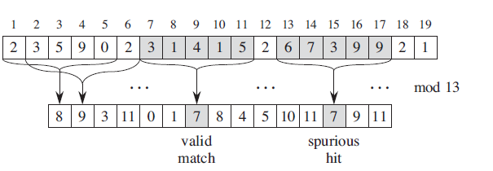
Spurious hits
Any shift s for which t_{s} ≡p mod q must be tested further to see whether s is really valid or we just have a spurious hit. It is a condition where the hash values match but the pattern and text within the window are not matching.

Slide 7
Time complexity of Robin Karp algorithm
Best case time complexity is O(m)
Worst case time complexity is O((n-m+1)m)
But average case is better.
O((n-m+1)+cm) where c is a constant. It is expected to get matching within some valid shifts.
O((n-m+1)+cm)≈O(n+m)

Slide 8
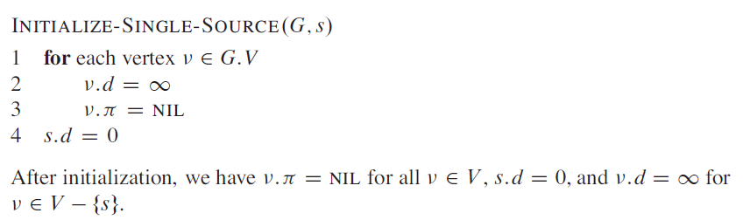
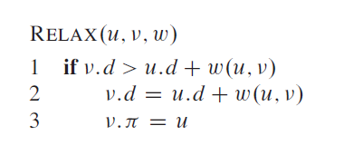
Bellman Ford algorithm- Single source shortest path
Given a graph G D<V,E>, we maintain for
each vertex vεV, a predecessor ∏ that is either another vertex or NIL.
Note: The algorithm finds single source shortest path of a directed graph with negative and positive weights. It cannot give the single source shortest path solution if the graph has negative cycles but the algorithm can be used for detecting negative cycles. If the distances even after (n-1)th relaxation changes, then it implies the graph has negative cycles. Because the distance values necessarily have to converge at (n-1)th iteration where ‘n’ is the number of vertices in the graph.

Slide 9
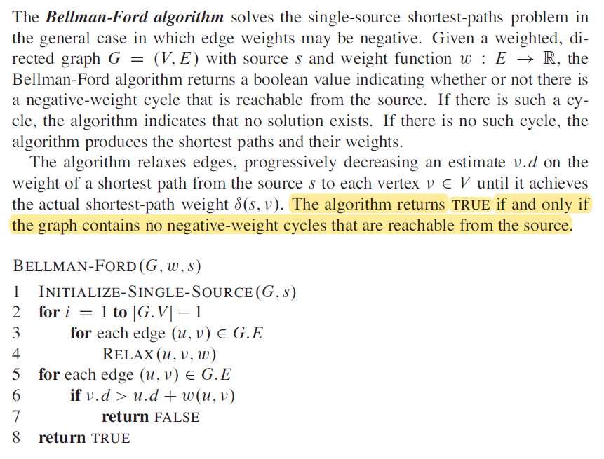
Bellman Ford algorithm- for detection of negative cycles in digraph
Note: Print all v.d values and that will give us the shortest distance from source to all other vertices ‘v’

Slide 10
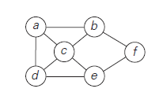
Hamiltonian cycle

Slide 11
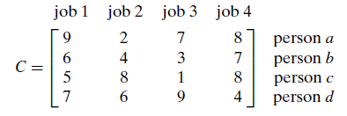
Branch and Bound

Slide 12
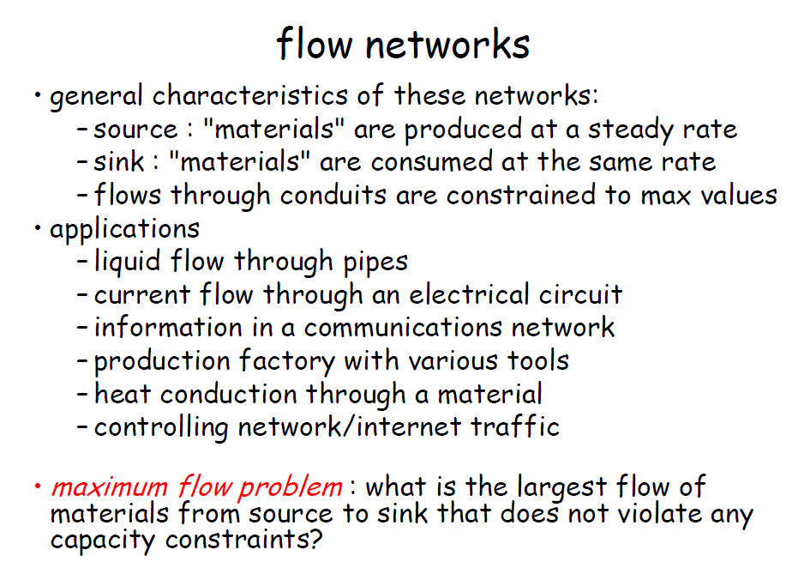

Slide 13
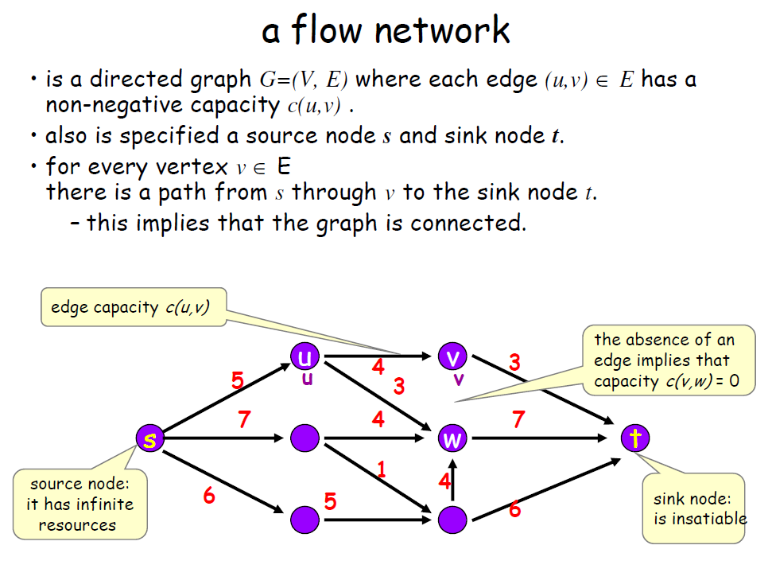

Slide 14
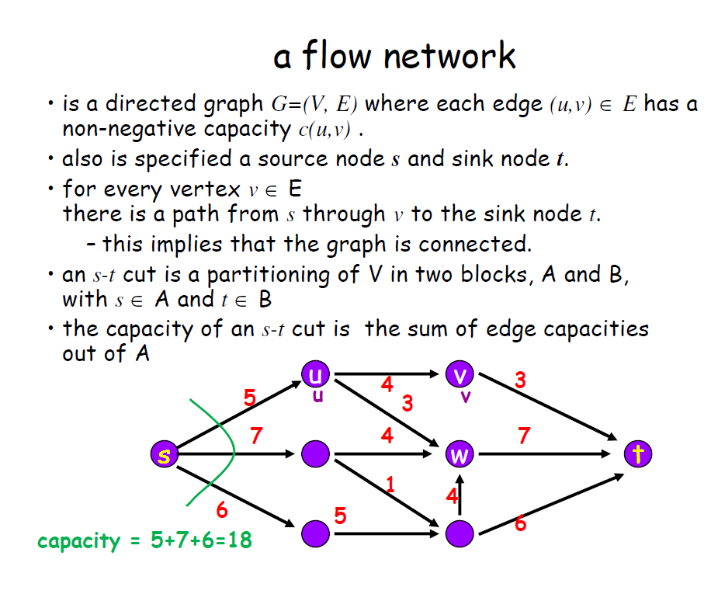

Slide 15
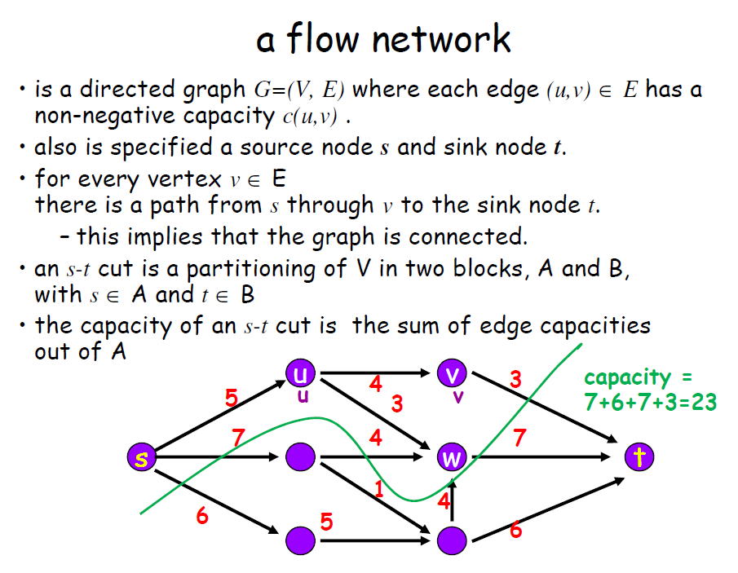

Slide 16
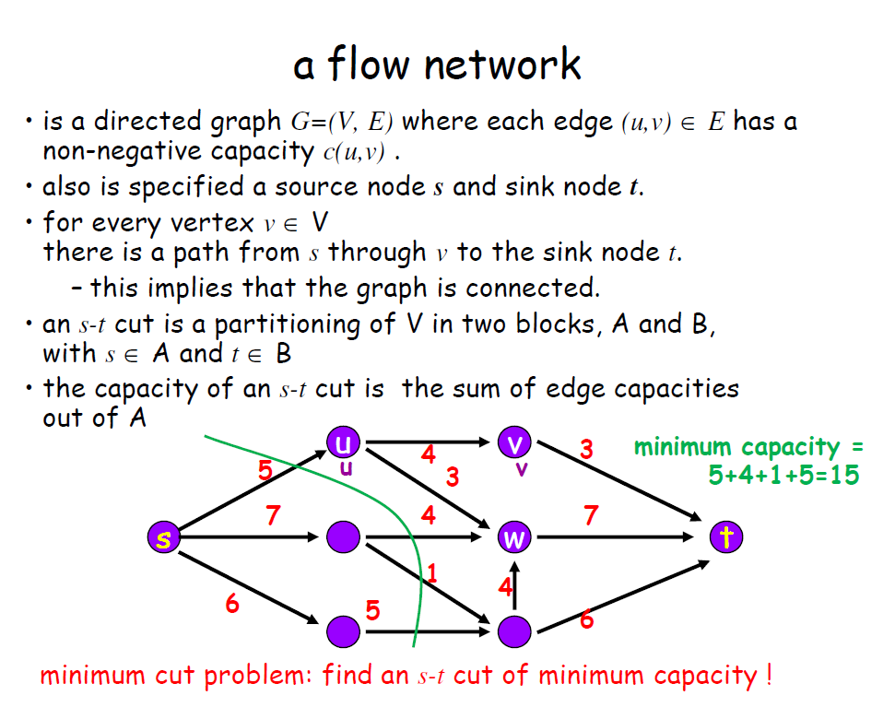

Slide 17
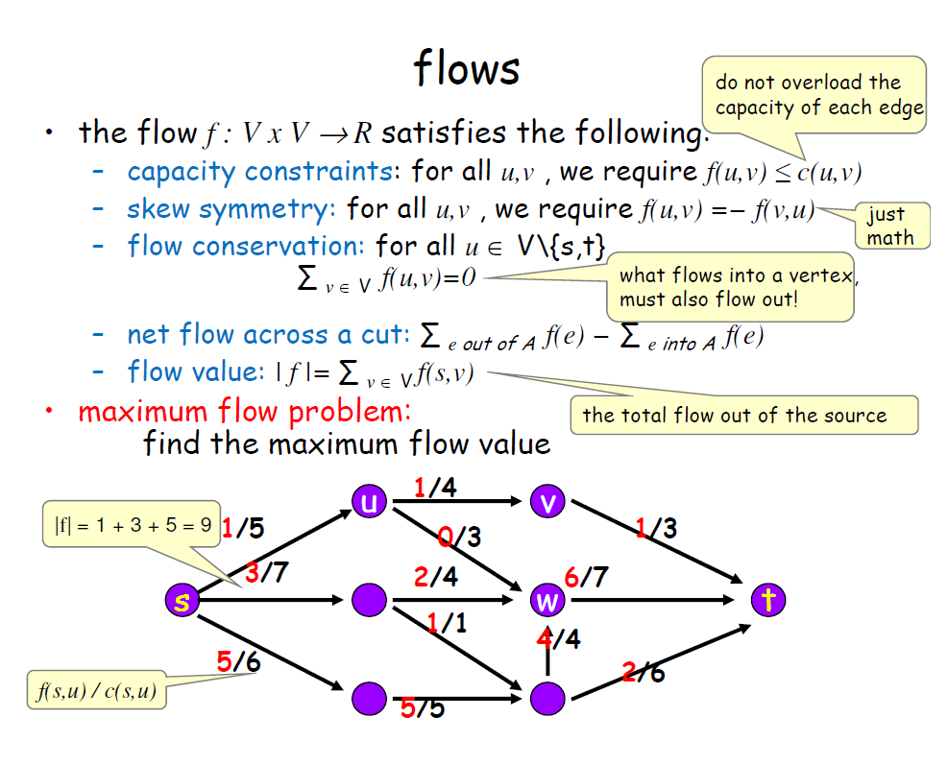

Slide 18


